Slide 1
Time Series EDA
Week 6 Session 2
Lecture and Slides by Jazzie R. Jao | jazzie.jao@dlsu.edu.ph

Slide 2
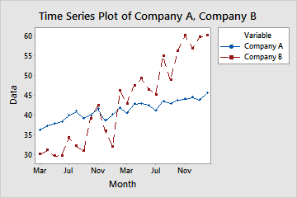
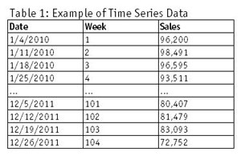
What is a Time Series Data?
Data points collected or recorded at specific time intervals.
Examples: Stock prices, weather data, air quality (PM2.5) measurements, sales data.

Slide 3
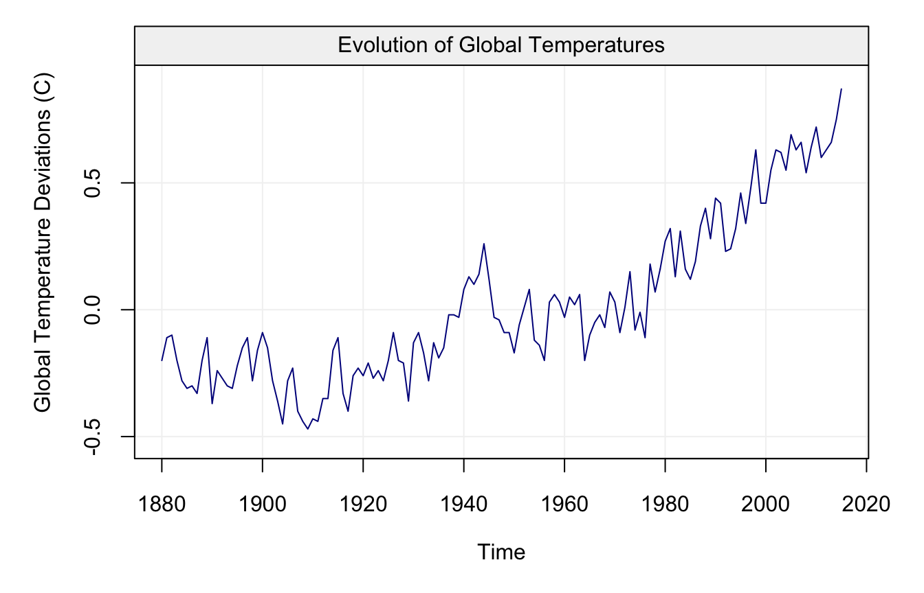
What is a Time Series Data?
Data points collected or recorded at specific time intervals.
Examples: Stock prices, weather data, air quality (PM2.5) measurements, sales data.

Slide 4
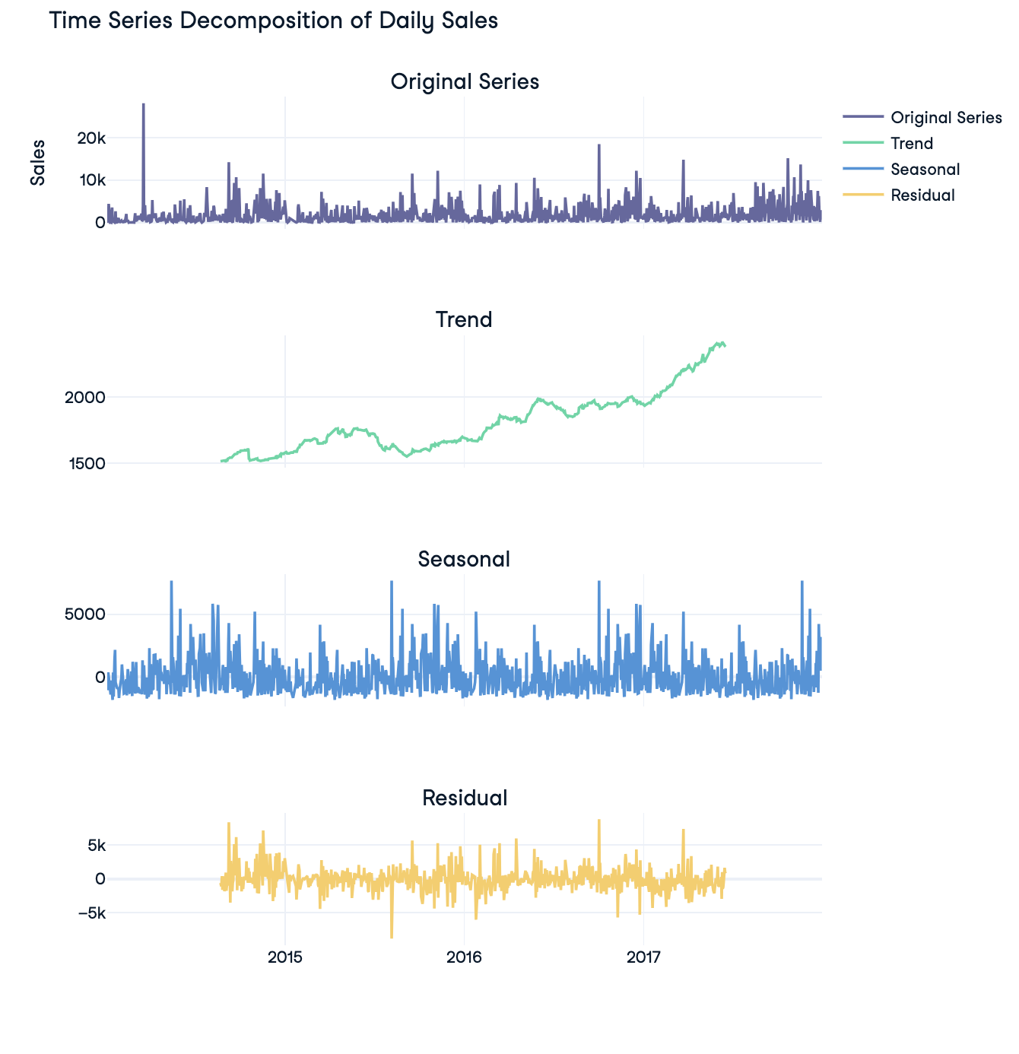
Technique Used: Seasonal Decomposition
Other techniques: EMD Decomposition, STL, etc.
>> from statsmodels.tsa.seasonal import seasonal_decompose
>> decomposition = seasonal_decompose(daily_sales['Sales'], model='additive', period=365)

Slide 5
Characteristics of Time Series Data:
Trend: A general, long-term upward or downward movement in the data.

Slide 6
Characteristics of Time Series Data:
Trend: A general, long-term upward or downward movement in the data.
Seasonality: Regular patterns that repeat at specific intervals (e.g., daily, weekly, monthly, or yearly).

Slide 7
Characteristics of Time Series Data:
Trend: A general, long-term upward or downward movement in the data.
Seasonality: Regular patterns that repeat at specific intervals (e.g., daily, weekly, monthly, or yearly).
Residual/Noise: This is the "noise" or the unexplained variation left after removing the seasonal and trend components.

Slide 8
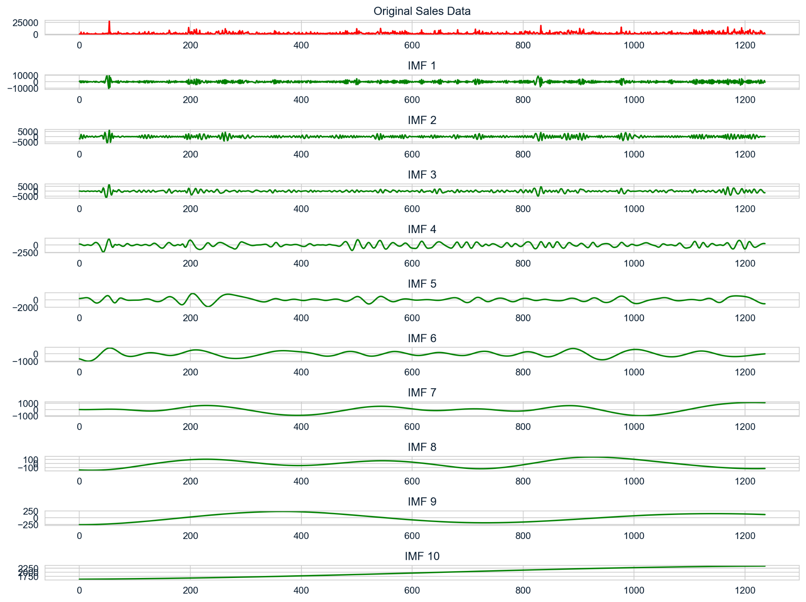
EMD Decomposition:
Gives you IMFs
Depends on the nature of the data
These signals are technically “derived” from your original time series.

Slide 9
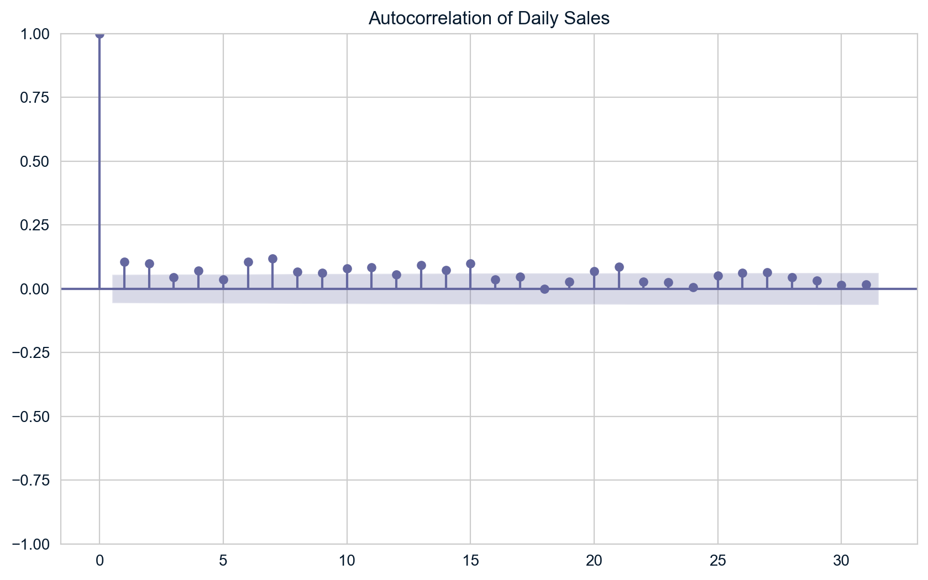
Autocorrelation
Lag: The horizontal axis represents the lags (time intervals) for which the autocorrelation is being calculated. In this case, it extends up to 30 lags.
At lag 0, the autocorrelation is 1, as expected since it represents the correlation of the series with itself at the same point in time.
For the subsequent lags (1 to around 30), the autocorrelation coefficients are generally low and hover around 0, indicating that the daily sales figures do not show significant correlation with their past values after the initial lag.
Autocorrelation Coefficient: The vertical axis shows the autocorrelation coefficients, ranging from -1 to 1. A coefficient of 1 indicates perfect positive correlation, while -1 indicates perfect negative correlation. Values close to 0 suggest little or no correlation.
Daily sales are not strongly influenced by previous days' sales.

Slide 10
EDA is Crucial for Time Series Data in Data Science
We want to detect trends, seasonality, stationarity, and noise before training a machine learning model.
Choose the correct preprocessing steps (e.g., differencing for stationarity).
Check for autocorrelation to design appropriate models.
Identify feature engineering opportunities (e.g., lag variables).
Use models that capture the inherent nonlinear relationship in your data.
This is the reason why becoming rich is difficult. 😟
Unless you can invent a mathematical framework that predicts nonlinear systems accurately! #motivation
TBH, almost all systems in our world are nonlinear tho.

Slide 11
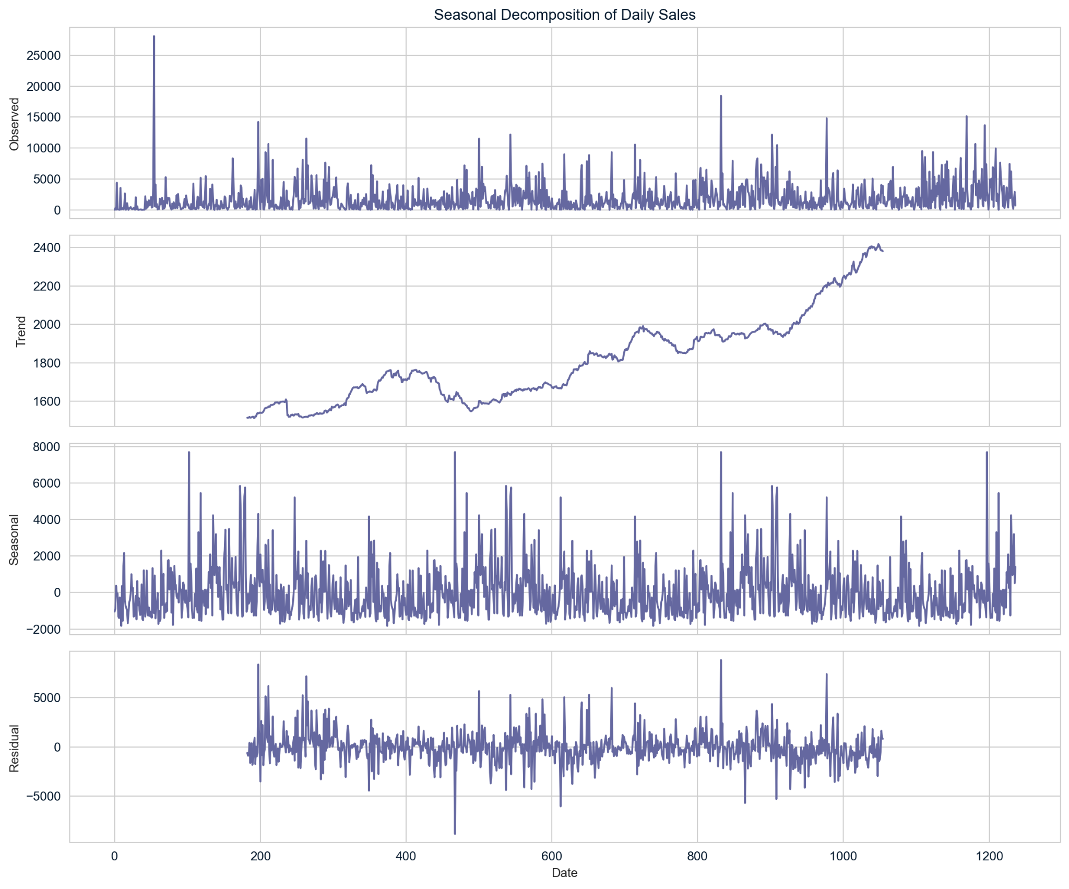
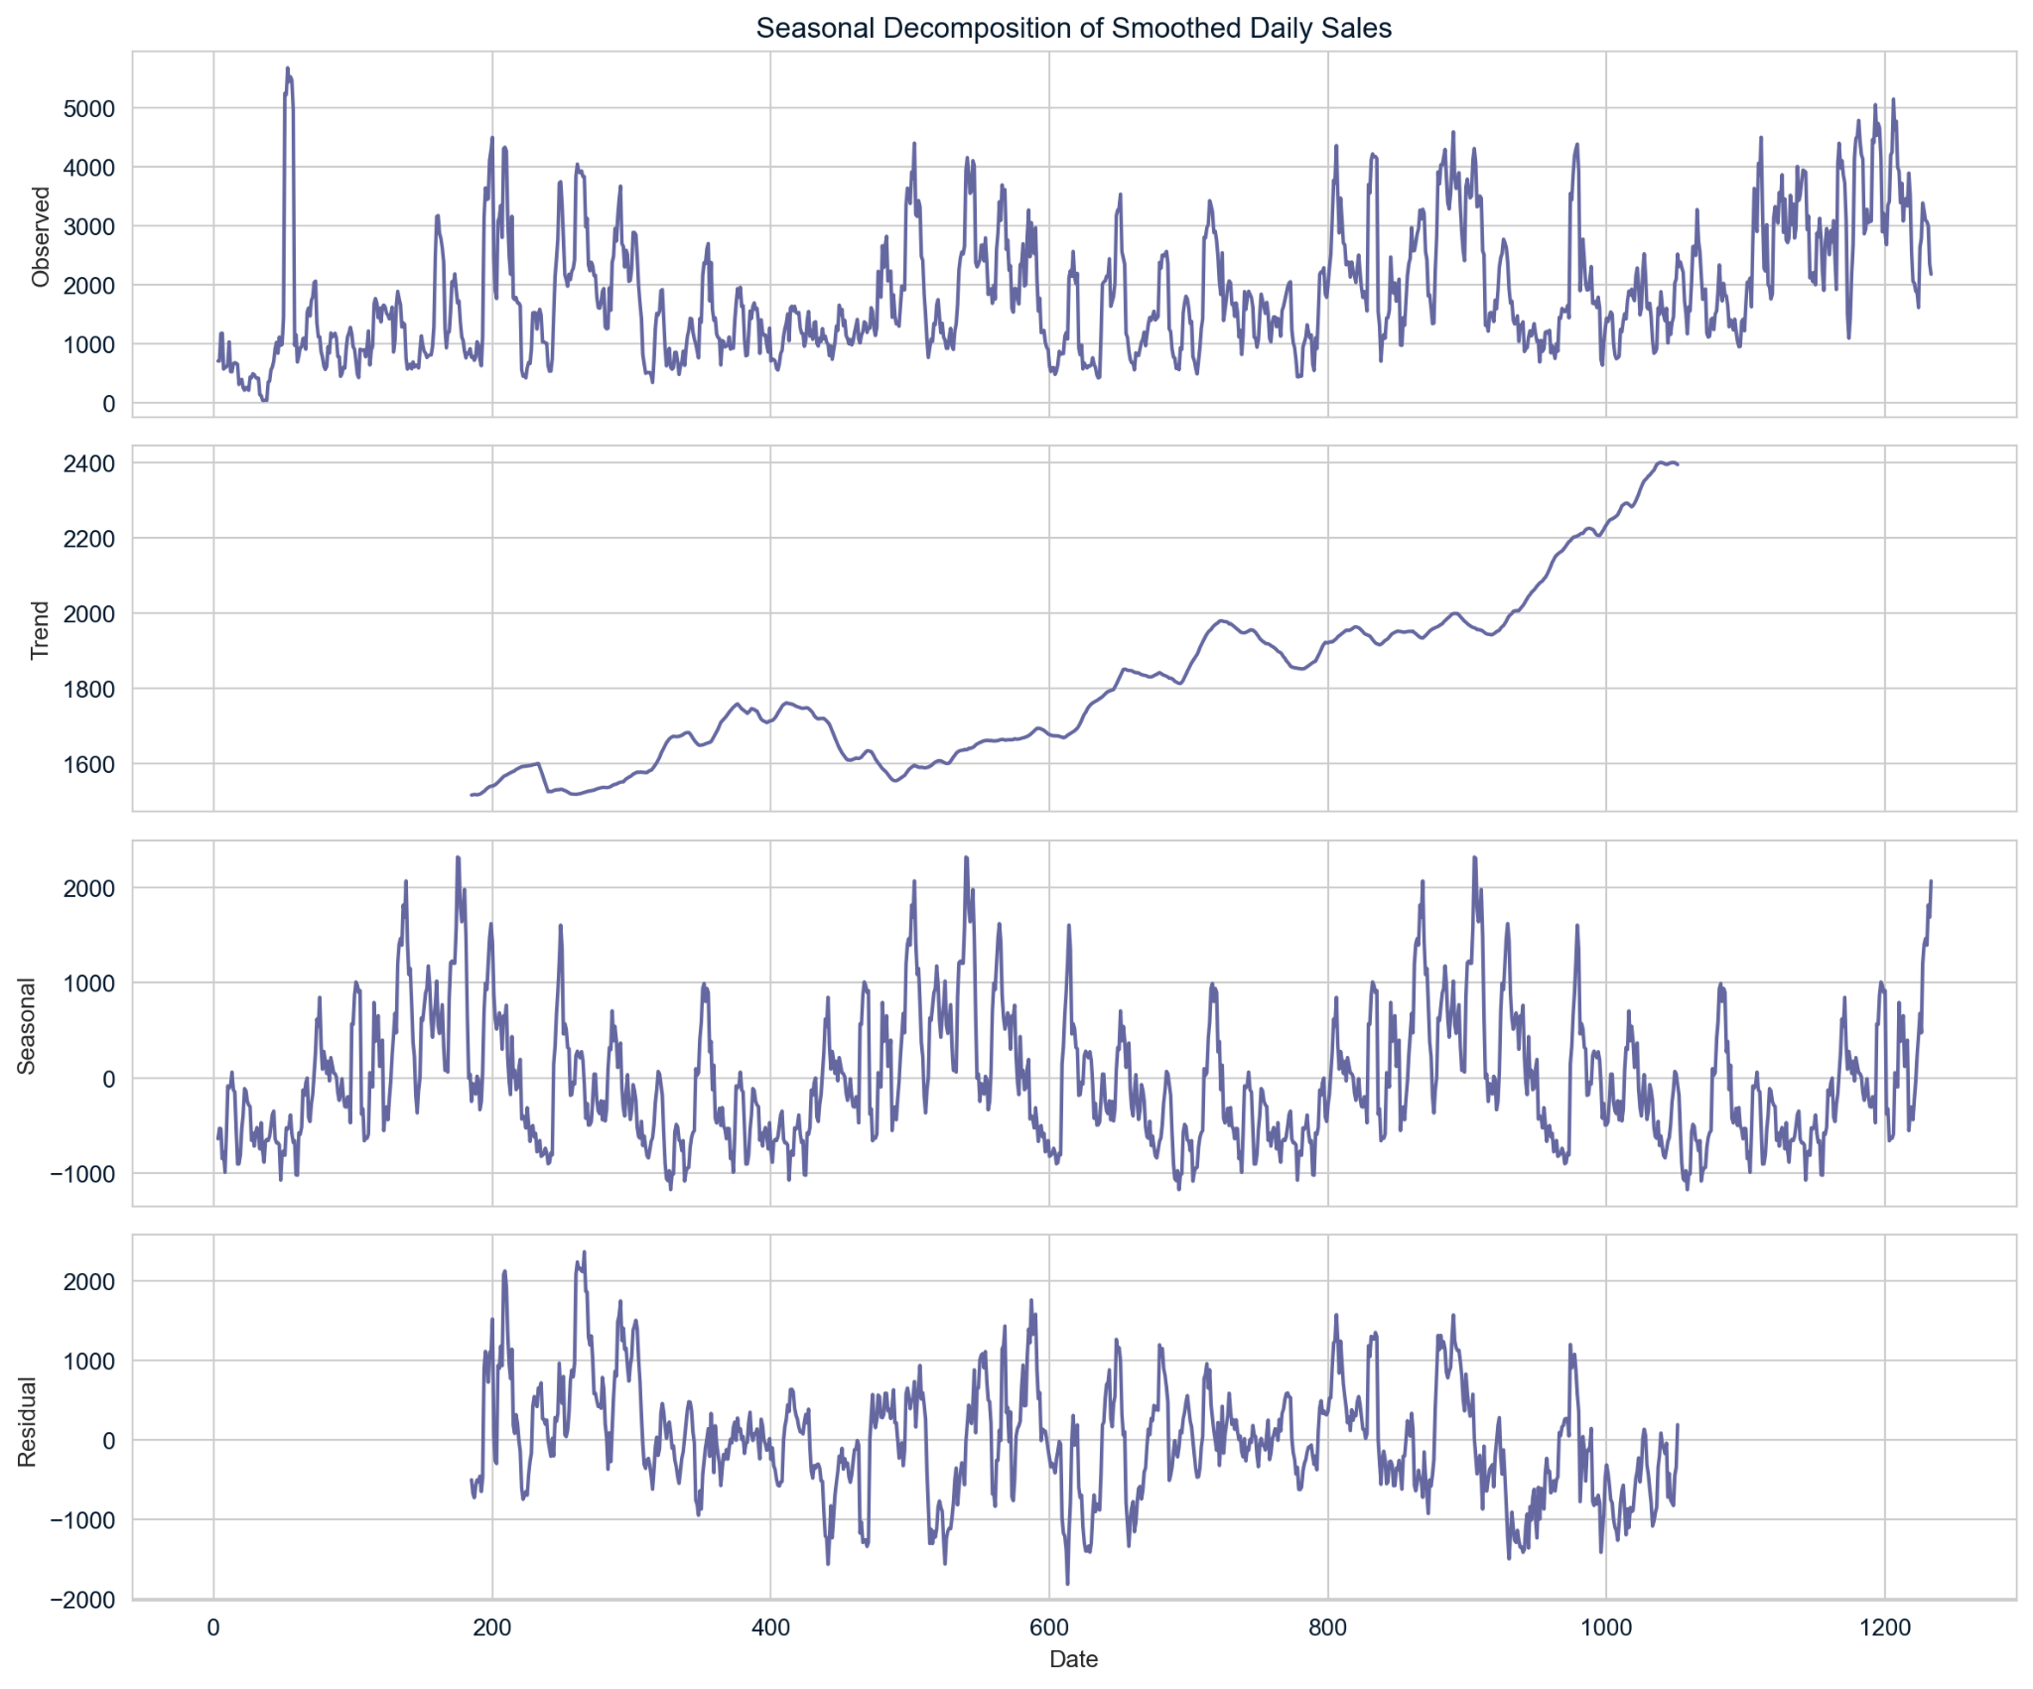
Smoothening
Noise can obscure the underlying structure of the data, making it harder to detect patterns or make accurate predictions. Smoothing techniques (e.g., moving averages, exponential smoothing) can help reduce noise and highlight important trends and seasonality.

